Slide 1
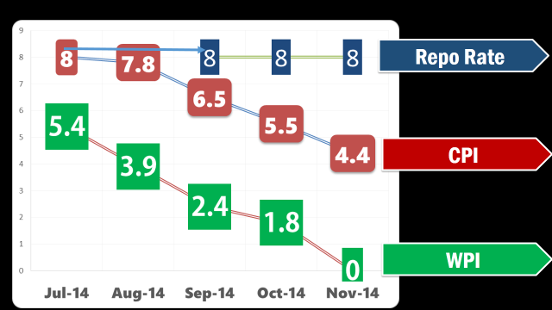
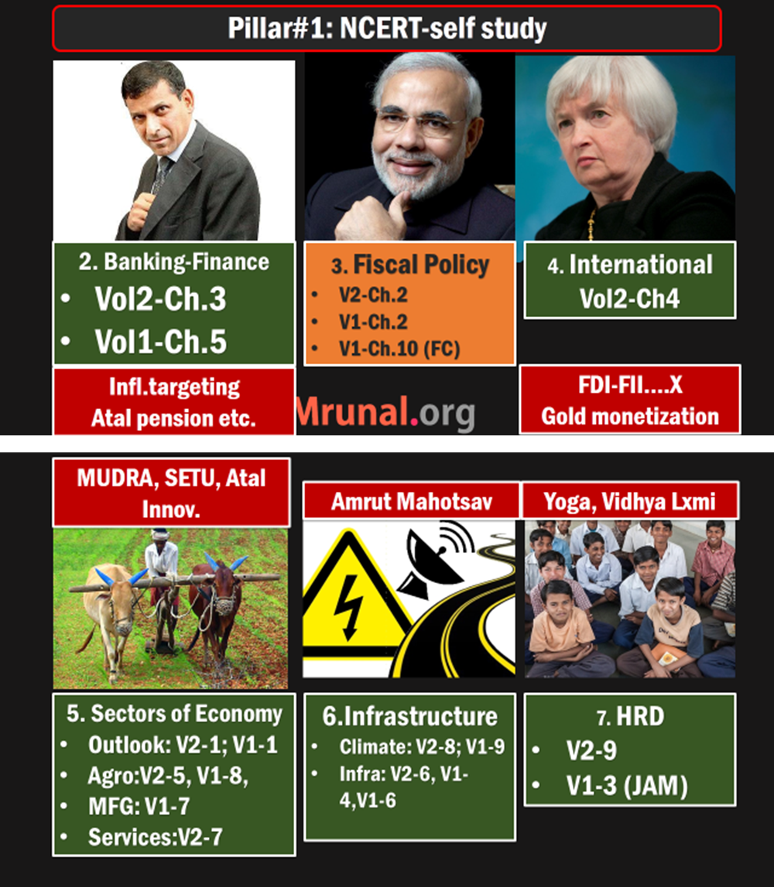
L1/P1
Monetary policy limitation
Urjit Patel, RBI Pact

Slide 2
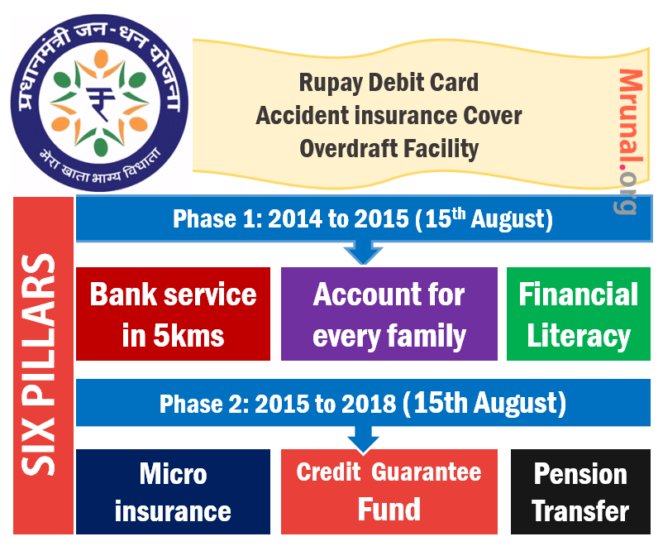
L1/P6 to P9
Financial inclusion
PMJDY, KVP, Small bank, Payment Bank

Slide 3
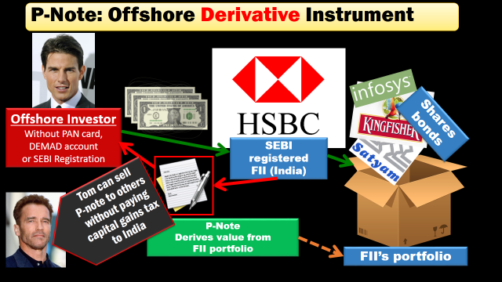
L2/P1
ETF- Disinvestment
P-Notes

Slide 4
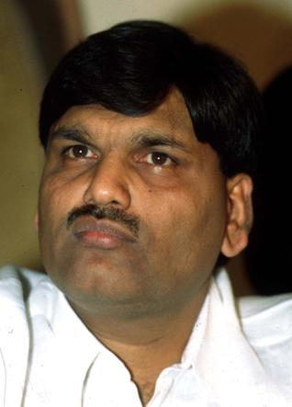
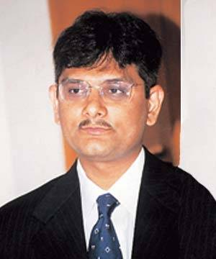
L2/P2
Harshad Mehta, Ketan Parekh
Sahara, NSEL, Saradha Chit fund, Satyam: FSLRC reforms

Slide 5
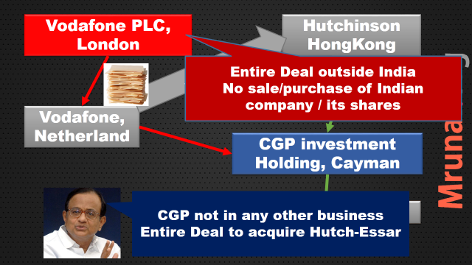
L2/P3
Cairn India, Vodafone, Nokia: larger picture “Fiscal imperialism”, DTAA models, GAAR

Slide 6
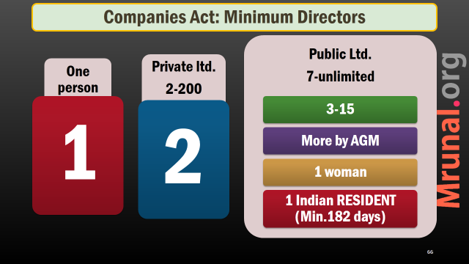
L2/P4 | L5/P3
Companies Act, Corporate Governance, CSR

Slide 7
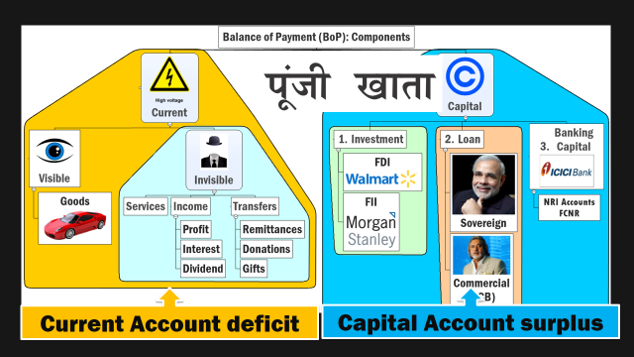
L3/P1 to P3
CAD ▼how to?
Capital Account convertibility
FDI: insurance, Defense
FTP-2015, TPP, RCEP (today)

Slide 8
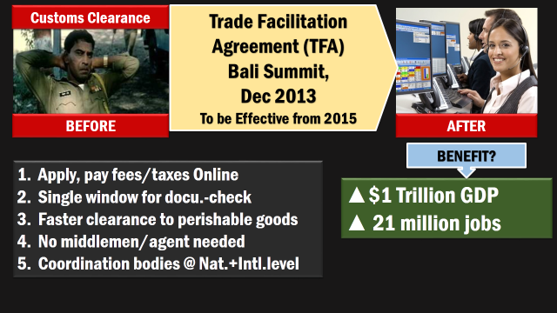
L3/P4: WTO-TFA, Food subsidies, IMF reforms, BRICS,AIIB
L3/P5: Bitcoins (IT grads.)

Slide 9
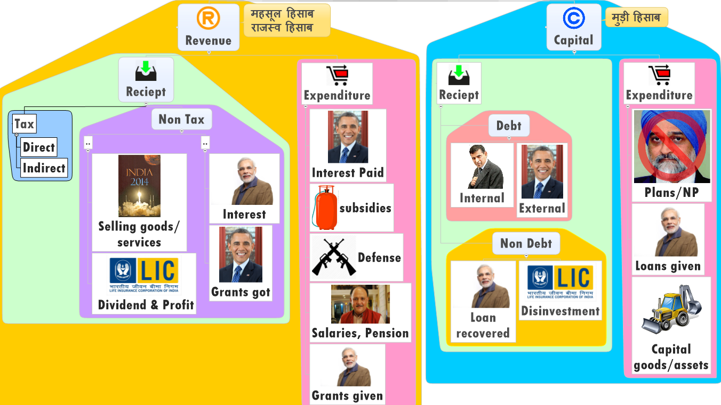
L4/P1-P2: Budget: Subsidies, Black money, Tax terrorism, GAAR postponed, DTC cancel, FRBM targets, PDMA

Slide 10
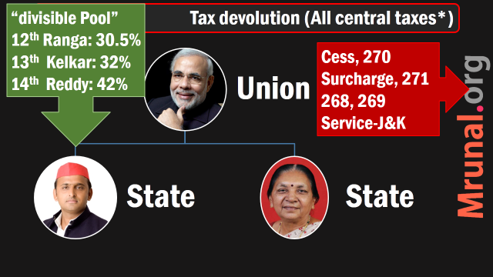
L4/P3: 14th FC (42%)
Parameters, benefits, criticism.
Guj: where to spend?
PRI/ULB, Disaster funding, utility of public pricing

Slide 11
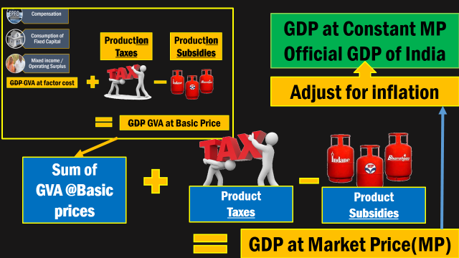
L5/P1: GDP calculation new method & its criticism

Slide 12
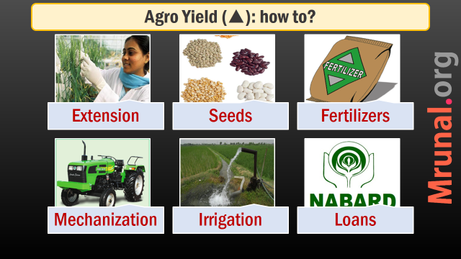
L5/P2: Agriculture problems, Soil Health card, FCI-Shanta Kumar, APMC reform (Gujarat)

Slide 13
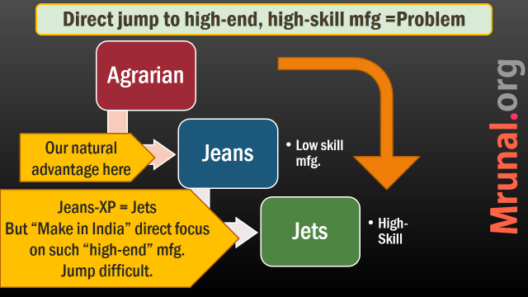
L5/P3,P4: Mudra Bank, Make in India, Skill India- features, challenges, Gujarat model why not inclusive (economic survey)

Slide 14
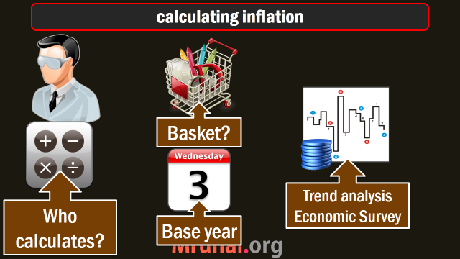
L5/P5: IIP-WPI-CPI trend. Why inflation declined. More steps?

Slide 15
Economy: Today’s Topics
Why Crude Oil price declined?
Reducing Gold consumption?
▲ Export: Foreign Trade Policy 2015?
RCEP, TPP: Indian Trade interests?
▲ Export: Region wise strategy?
Product wise strategy? Engineering, IT, Pharma/Medical.

Slide 16
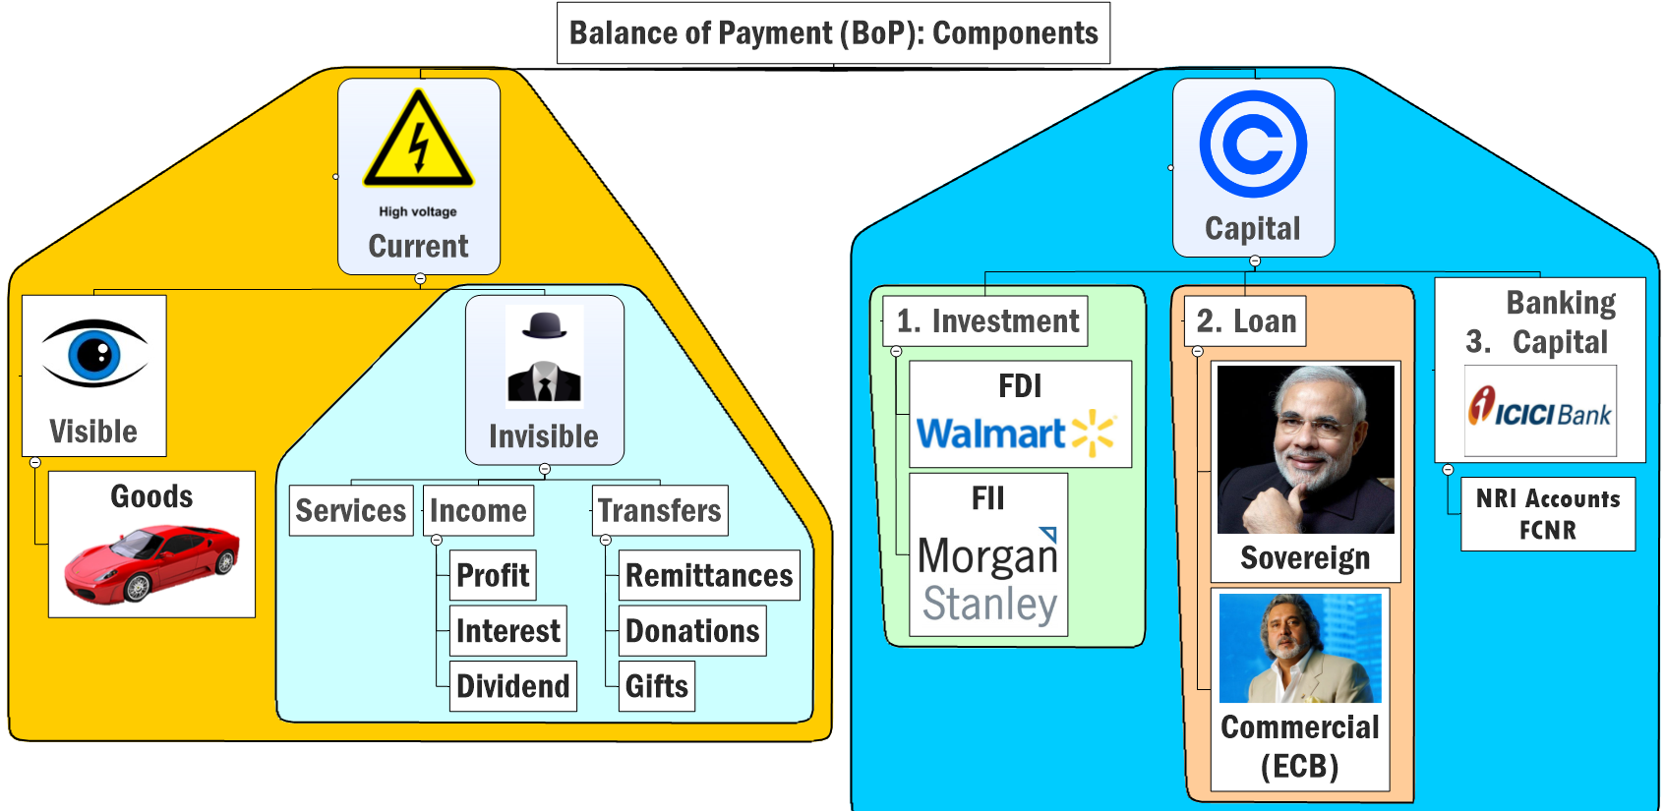
Trade deficit ▼ : Crude Price ▼, Gold consumption▼

Slide 17
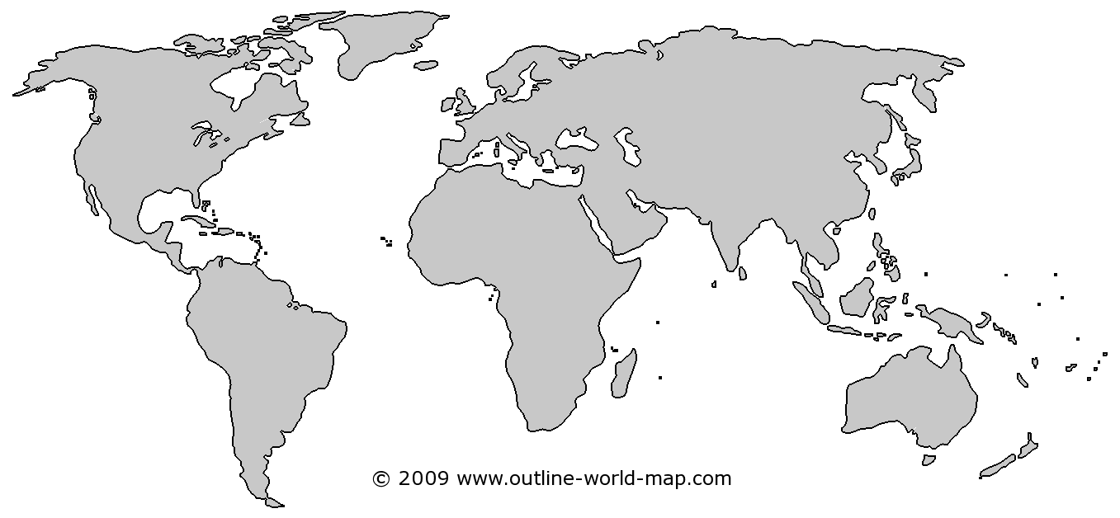
Oil expected ~60-65$ in 2015-16.
EU, China
growth▼
US: Shale Gas, Oil ▲
OPEC Oligopoly ▼
Saudi did not cut production
Notes:
from >100 per barrel to <50$
China, EU Growth▼=oil demand ▼
US oil + shale gas production ▲
OPEC oligopoly ▼, S.Arabia did not ▼ production
Survey predicts: $60-65 / barrel, so, inflation and CAD will be moderate for 2015-16

Slide 18

Lack of fin. Inclusion + black money park = Gold craze
Inflation
-ve Real Interest rate
Gold purchase
CAD ▲
Rs.▼

Slide 19
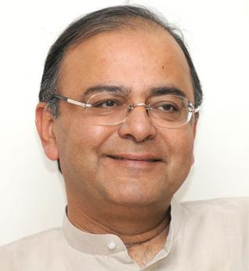
Purple=budget announced
Custom Duty (10%)
IIB, Jan Dhan, KVP
Monetization Scheme
Ashok Coins + PAN CARD
80:20 Rule
Sovereign Gold Bond
Gold
Notes:
2% duty was in 2012
Smuggling
jewellers
A plan by the Reserve Bank of India (RBI) to swap old gold in its vaults for purer metal abroad that it could pledge or sell would have the added benefits of reducing gold imports and easing pressure on the balance of payments.
The RBI would sell relatively impure gold from its own vaults - some dating back to before independence - and receive the equivalent worth of purer yellow metal delivered to the Bank of England, under a scheme outlined on Wednesday.
The swaps would not involve money changing hands, according to three officials aware of the development.
The RBI has parked gold abroad in the past, once in the throes of the 1991 financial crisis. It did a similar swap in 1998, according to a report at the time, before Russia's default and devaluation caused a meltdown across emerging markets.

Slide 20

Impact on Indian Economy
Oil
Oil + gold = 45% of import bill.
Overall, $9.5 billion less burden on Current Account (2014-15)
So, CAD, inflation both moderated

Slide 21
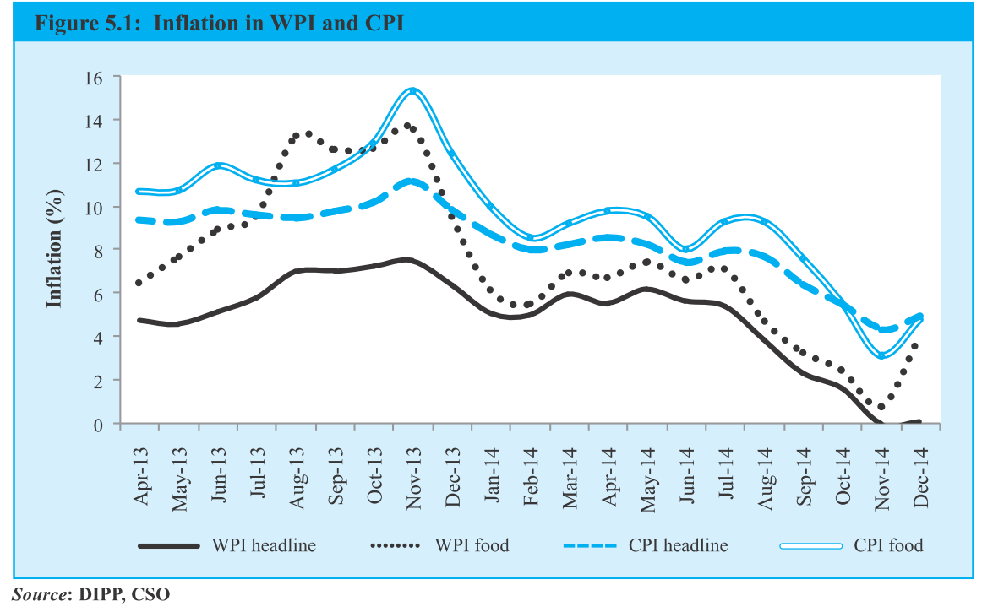
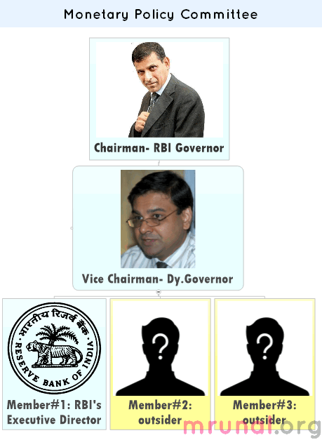
Inflation angles
Trade deficit Oil, Gold
Inflation (L5/P5)
Agro (L5/P2)
RBI (L1/P1)

Slide 22
Trade deficit ▼ : Crude Price ▼, Gold consumption▼

Slide 23
Overall : Trade Deficit but individual region differs
Trade surplus
Trade deficit
EU
USA
Africa
ASEAN
China
Middle East

Slide 24

Next topic: BOOST EXPORTS?

Slide 25
Boosting Exports
Why? Problems
How? Foreign Trade Policy
External
Domestic
Laws-taxes

Slide 26
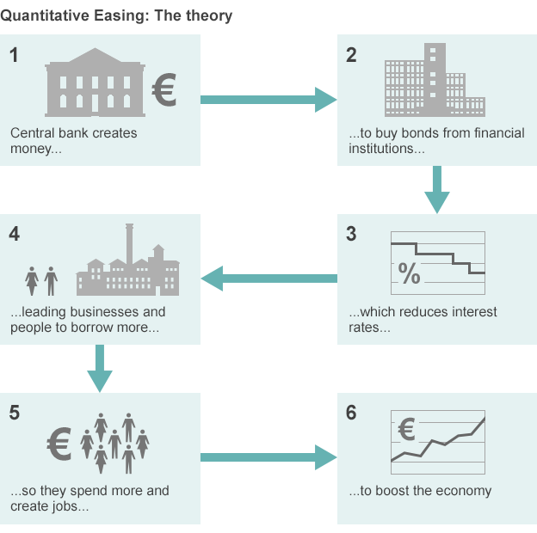
BBC chart
QE
Notes:
http://www.bbc.com/news/business-30933515

Slide 27

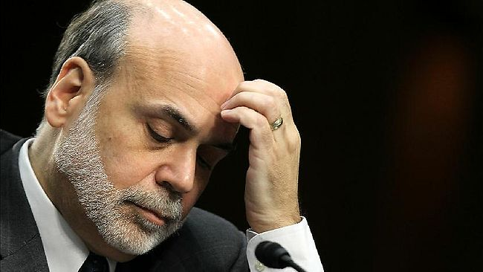


US Fed Reserve
Ben Bernanke
New money generated
85 Billion $ per month (Dec ‘13)
Fed buys
Treasury bonds and Toxic Assets
Notes:
In March, the ECB and national central banks of euro zone member states will start buying 60 billion euros of chiefly government debt each month. That figure includes rebundled private debt, asset-backed securities and covered bonds, typically worth about 10 billion euros, on top of the roughly 50 billion euros in state bonds. The plan is to buy until September 2016 or until there has been a "sustained" improvement in consumer price inflation, which recently turned negative. The programme could end earlier if successful, or be extended if its impact is small.
http://www.smh.com.au/business/markets/qe-explained-how-the-ecbs-quantitative-easing-plan-will-work-20150123-12wdji.html

Slide 28
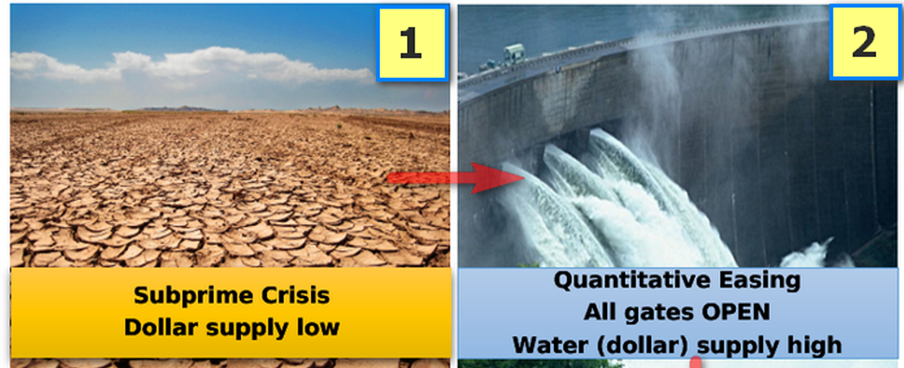
Hot money flow to India
$1: 39 Rupees = not good for Indian exporters

Slide 29
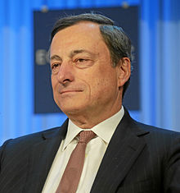
ECB Chairman
Mario Draghi
£60 billion/ month (from Mar’ 15
£10: private bonds
£50: State bonds
(BBB- or above)
Till Sep 2016 (or CPI ▲)
£ 1.1 trillion injected
Notes:
In March, the ECB and national central banks of euro zone member states will start buying 60 billion euros of chiefly government debt each month. That figure includes rebundled private debt, asset-backed securities and covered bonds, typically worth about 10 billion euros, on top of the roughly 50 billion euros in state bonds. The plan is to buy until September 2016 or until there has been a "sustained" improvement in consumer price inflation, which recently turned negative. The programme could end earlier if successful, or be extended if its impact is small.
http://www.smh.com.au/business/markets/qe-explained-how-the-ecbs-quantitative-easing-plan-will-work-20150123-12wdji.html

Slide 30

External विदेशी कारण
FTP-2015
QE in US and EU
Strong rupee => bad for exports
Regional trade agreements among giants esp. TPP, TATIP

Slide 31
Boosting Exports
Why? Problems
How? Foreign Trade Policy
External
Domestic
Laws-taxes

Slide 32
Domestic देशी कारण
Export▼
Indian Inflation higher than world. (some angles covered)
Infrastructure bottlenecks in highways, ports, Internet, electricity, water, gas. (Survey bottom-line: more public investment in Railways)
State governments passive
Substandard products. Branding, packaging and advertising focus missing. "Zero Defect" required.

Slide 33
Boosting Exports
Why? Problems
How? Foreign Trade Policy
External
Domestic
Laws-taxes

Slide 34
Laws & Taxation
Trade ▼
FDI restriction
High tariff on imported raw material
Tax terrorism (L4/P2.pptx)
GST delayed (1/4/2016) (L4/P8)
Industrial & labour laws (L5/P3.pptx)
Stable agriculture export Policy..X
high transaction cost: paper forms, inspection, inspector raj, red tapes.
Ease of doing Biz 2014: 142/189

Slide 35
Foreign Trade Policy?
Why Exports ▼?
How? Foreign Trade Policy
External
Domestic
Laws-taxes
Make in India
Skill India
Export promotion Mission
Digital India
L5/P4

Slide 36
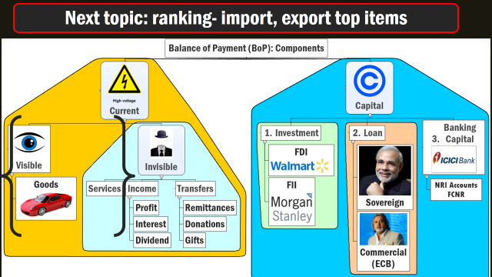
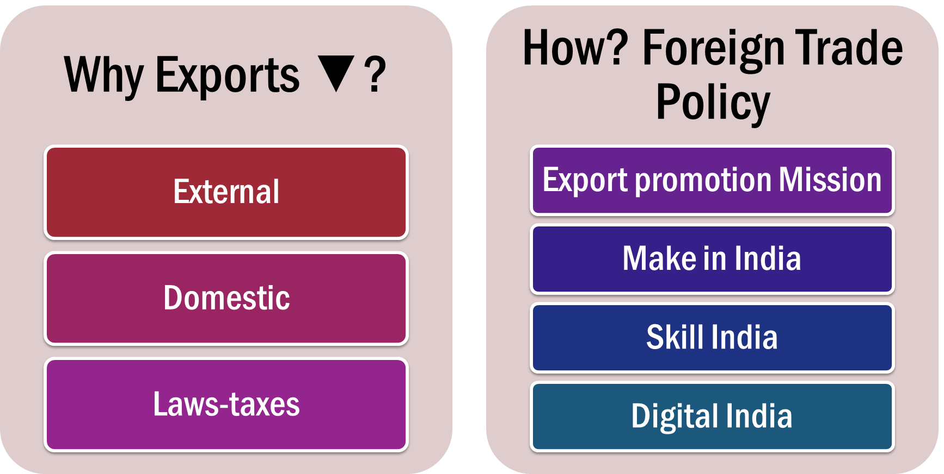
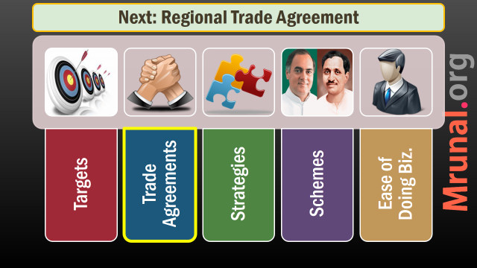
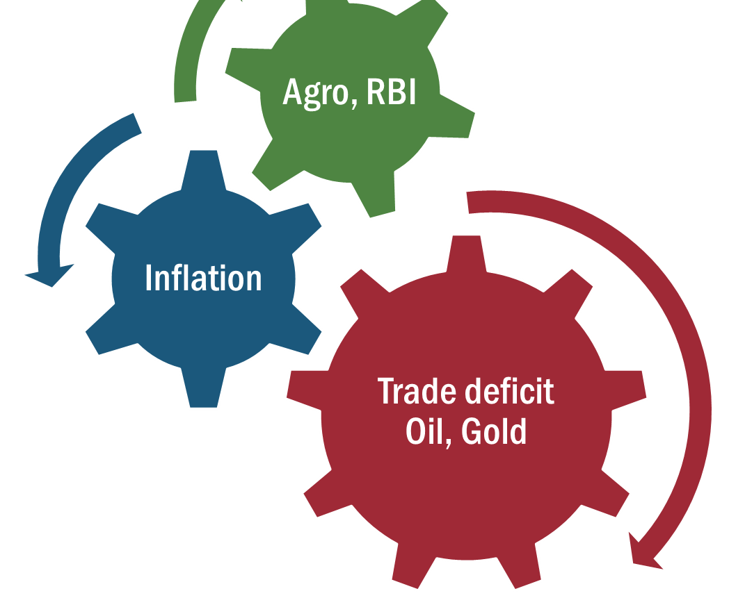
FTP-2015 to boost EXPORT

Slide 37

DGFT Comm.Min.
FTP-2015
Year | Export (US billions.) | World Share in Export
2013 | 465 | 2%
2020 31st March | 900 | 3.5%

Slide 38
5 Stages / evolution
PTA (7)
Common Market/Custom Union (MERCOSUR)
FTA, CECA, CEPA (11)
Multilateral / Regional TA
Economic Union (EU)
TPP, RCEP

Slide 39
1+2 = Erode Indian grip over US-EU markets
TPP
RCEP
TATIP
Together, 50% of world trade captured.
33% of World Trade
50% of population

Slide 40

TATIP
Agreements
Trans-Atlantic Trade and Investment Partnership
Between US and EU

Slide 41
TATIP India hurt bcoz
Agreements
~0% import duty for their products= Tariff barrier for India, China
Stringent quality norms, environment norms, faster clearance to US/EU = Non-Tariff barrier for India China.
E.g. pesticide residues in oranges (Nagpur vs Florida); Lead / heavy metals in mfg. goods/toy etc.

Slide 42
1+2 = Erode Indian grip over US-EU markets
TPP
RCEP
TATIP
Together, 50% of world trade captured.
33% of World Trade
50% of population

Slide 43
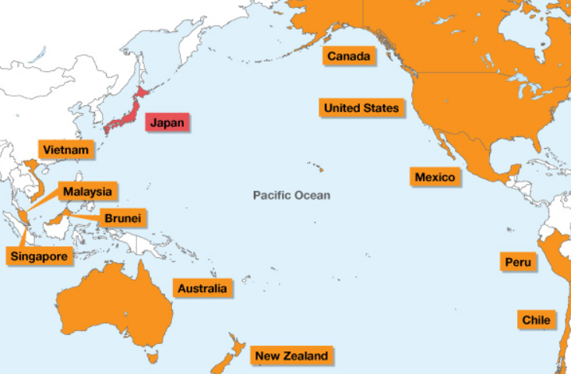
TPP: 12 members :USA + Canada + 10 Asia-Pacific

Slide 44
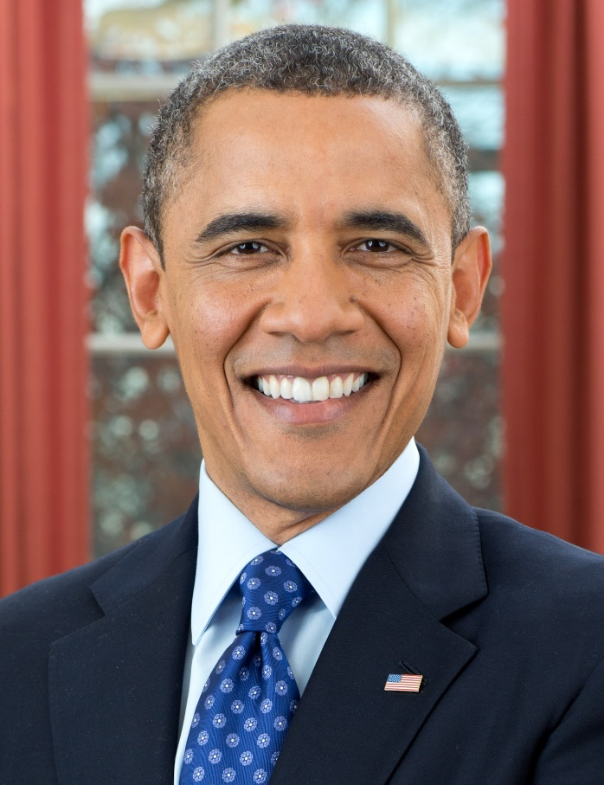
Salient Features
TPP
Trans pacific partnership
▲ Export of “Made in USA” goods and services.
Tariff barriers: 0%
Non tariff barriers: Minimal.
Sync. All partners with American environment, labour, IPR laws

Slide 45
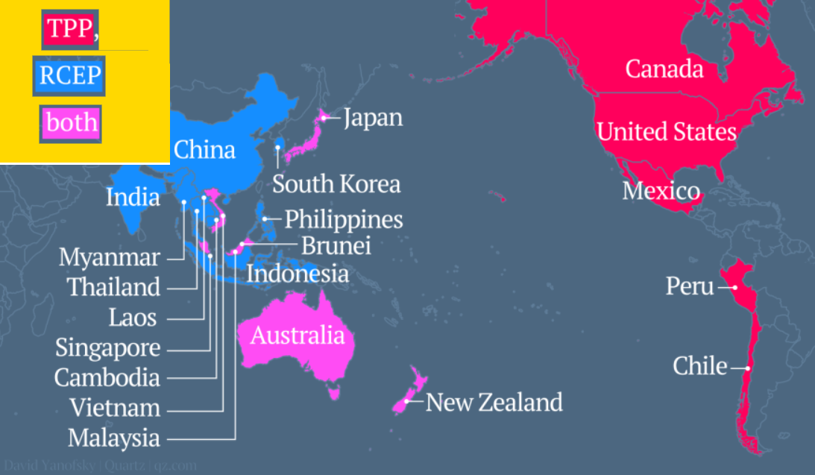
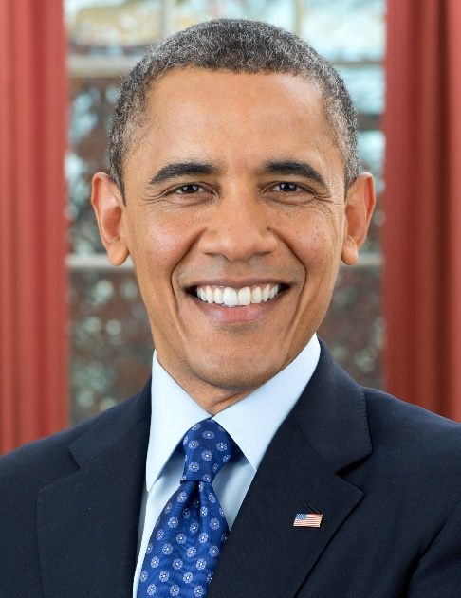
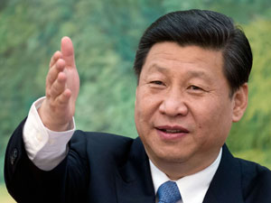
RCEP: China, India, ASEAN, Jap, Korea, Aus., NZ

Slide 46

If we don’t join TPP?
TPP/RCEP?
7 countries- Australia, Brunei, Japan, Malaysia, New Zealand, Singapore and Vietnam in both TPP and RCEP
EU QE+Slowdown = Indian Exports ▼
TPP+TATPI= tariff & non tariff barriers, in the name of environment, labour rights, IPR
RCEP weaker on above fronts (bcoz China itself gross violator).

Slide 47
India should join TPP?
RCEP/TPP
TPP: timing and terms yet unclear
If we want to join, then must reform environment, labour, IPR front in advance, to align with developed nations. (Economic Survey)
India cannot be a part of it coz our social-economic development goals. Compliance Cost high Agro, Mfg. & service industries. (FT-Policy 2015)
Notes:
Lead in paint
Server security

Slide 48
Mains / Interview
Examine the opportunities and constrains for India, in joining TPP. 150 words.
Easy Entry in 12 nations. Make outside India in Peru/Mexico => USA export.
Quality norms difficult to implement
If 0% tariff to American agro imports = Indian farmers hurt.

Slide 49
1+2 = Erode Indian grip over US-EU markets
TPP
RCEP
TATIP
Together, 50% of world trade captured.
33% of World Trade
50% of population

Slide 50
RCEP Members?
10 ASEAN
Brunei
Cambodia
Indonesia
Lao PDR
Malaysia
Myanmar
Philippines
Singapore
Thailand
Vietnam
6 ASEAN FT Partners
China
India
Jap
Korea
Aus.
NZ

Slide 51
RCEP
Trade grouping
India: a member.
Obligations to reform environment / Labour laws: not much.
Generous Exemptions to protect local industry: yes
lenient timetables for implementation: yes
Ideal to join such global value added chain. Produce in nearest low cost destination. (CMLV)

Slide 52
Mains / Interview
Discuss the significance of ASEAN-FTA and RCEP on India’s economic interests in Asia. 150 words.
TPP and RCEP- the Manifestation of Economic rivalry between US and China, will have profound impact on India’s foreign trade. Elaborate. 200 words.

Slide 53

Way ahead?
FTP-2015
~400 trade agreement in action among countries
India should Make agreements with countries where
India has potential market
India can source raw material / components.

Slide 54
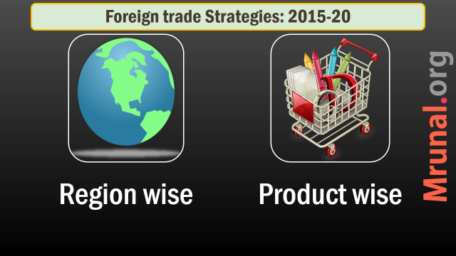
Strategies to boost EXPORT

Slide 55
FTP-2015: Region wise Strategies (8)
US,EU
China, Japan
SAARC
ASEAN
WANA
LAC
Russia,CIS
Africa

Slide 56
US/EU
FTP-2015
USA: back to growth part
Indian Gems and jewelry, agriculture to pickup.
But Trans pacific and trans Atlantic partnerships pose challenges.

Slide 57
European Union
FTP-2015
EU: largest trading partner of India
But, SPS, TBT used against Indian products (e.g. Mangoes & Vegetables)
Natural movement of Indian professionals difficult than in US

Slide 58

European Union
FTP-2015
Data security laws: only big Indian firms can enter.
Environment, child Labour laws.
IPR laws, patent issues.
Broad-based Trade and Investment Agreement (BTIA) under negotiation for years because of 1 + 2 + 3

Slide 59
EU Way Ahead
FTP-2015
Focus: defense equipment, medical equipment, construction material, processed foods
Discussing trade agreements with Turkey & Visegrad-4 (Czech Republic, Hungary, Slovak Republic, Poland)
Explore: Aus, NZ

Slide 60

Non-EU focus
FTP-2015
Australia: six crucial inputs: iron ore, coking coal, copper, gold, uranium and LNG
NZ: Expertise in dairy, meat and wool = sharing best practices and technology

Slide 61
FTP-2015: Region wise Strategies
US,EU
China, Japan
SAARC
ASEAN
WANA
LAC
Russia,CIS
Africa
Agro/ICT challenges
Explore non-EU

Slide 62

SAARC Present
FTP-2015
South Asian Association for Regional Cooperation
Mere 20 billion$ trade.
Largest trading partner: Bangladesh > Sri Lanka > Nepal > Pak.
0% duty market access given to L.D.C – Bhutan, Maldives et al.
problem: Pakistan

Slide 63

MFN from Pak
Policies
WTO: GATT, GATS =MFN concept.
If trade barrier lowered for most favored nation (MFN) then all trading partners be treated in same manner.
97: India gave MFN status to Pak

Slide 64
MFN from Pak
Policies
But pak still keeps ~1200 items India can't export- textile, agro, automobile parts = SMUGGLING
2012: new talks but stalled.
40% Pak-workforce in textile, vote bank-lobbying

Slide 65
SAARC Solution
FTP-2015
Prepare a 5-year action plan
Value added chain chains for textiles, leather, tourism, automobile, healthcare
Conclude SAFTA- in services.
Border Infrastructure
Multimodal connectivity.
SAARC Energy Grid (Article Link)

Slide 66
FTP-2015: Region wise Strategies
US,EU
China, Japan
SAARC
ASEAN
WANA
LAC
Russia,CIS
Africa
Env/ICT challenges
Explore non-EU
SAFTA service, Grid, Value added chain

Slide 67
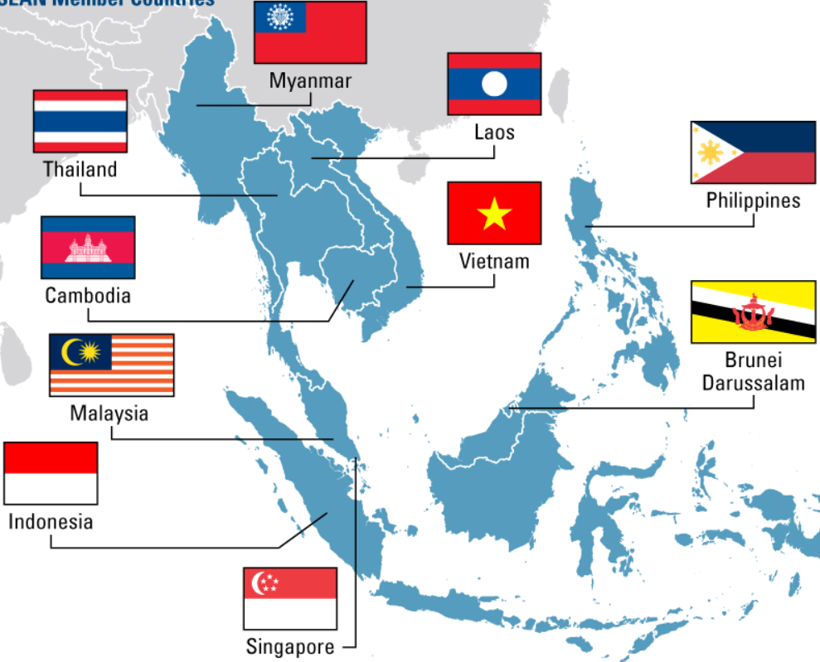
Association of South East Asian Nations (10)

Slide 68
India’s largest trading partner (decreasing order)
Singapore- FTA signed
Indonesia- FTA signed
Malaysia- FTA signed
Thailand- in progress

Slide 69

India ASEAN
FTA
FTA in Goods: 2009 sign ‘10 start
FTA in services: 2014= 9/10 ASEAN signed
Philippines: apprehensive of Indian IT/BPO competition.
FTA Services WEF: 1 July 2015

Slide 70
BENEFITS?
FTA-Services
Easy movement of Man and money (investment)
By 2015: trade $100 billion
Joint review, dispute settlement
Later Regional RCEP with Aussies, China, SK, NZ and Japs

Slide 71
1st FTA with ASEAN, then joining RCEP
10 ASEAN
Brunei
Cambodia
Indonesia
Lao PDR
Malaysia
Myanmar
Philippines
Singapore
Thailand
Vietnam
6 ASEAN FT Partners
China
India
Jap
Korea
Aus.
NZ

Slide 72
ANTI?
FTAs
Mutual recognition of degrees needed. (Modi pitching for it)
Inverted duty structure.

Slide 73

Duty inversion
FTA
Import of Final goods = 0% (e.g. laptop from ASEAN)
Import of raw material = 10% custom duty (e.g. laptop battery) => India made laptop expensive than ASEAN laptop.
Import ▲ but export did not
Therefore FTAs hurting Indian economy.

Slide 74
ANTI-ANTI
FTAs
Comm.ministry expert panel: FTAs not culprit:
FTA have enough safeguards.
No data to prove dumping in India.
High cost of doing business.
Need to become part of Asian value chain. Get intermediate goods=>re-process=>export. (MAKE Outside India CMLV)

Slide 75
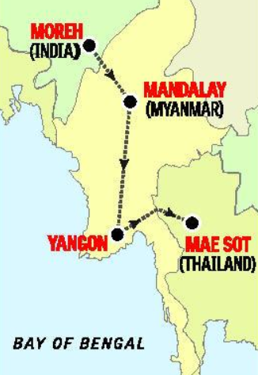
ASEAN Connectivity
FTP-2015
Myanmar borders with- 4 Indian states
Arunachal, Nagaland, Mizoram and Manipur
India-Myanmar-Thailand trilateral highway.
May extend to Cambodia, Laos, Vietnam (= make outside India)
Will be part of Asian Highway network AH-1. (= CMLV2China)

Slide 76
FTP-2015: Region wise Strategies
US,EU
China, Japan
SAARC
ASEAN
WANA
LAC
Russia,CIS
Africa
Env/ICT challenges
Explore non-EU
SAFTA service, Grid, Value added chain
FTAs: pro, anti
transport
(GS2) Bilateral, regional & global groupings and agreements involving India and/or affecting India's interests
(GS2) Effect of policies & politics of developed and developing countries on India's interests.

Slide 77
2016: China to amount for 25% of Our trade deficit
India
Export2 China
20 Billion
China
Export2 India
80 billion
Trade surplus

Slide 78
China why trade imbalance?
North Asia
China’s SOE (State Owned Enterprises) Opaquely control domestic IT-market.
Non tariff barriers on Indian food – pharmaceutical

Slide 79
Pharma
FTP-2015
Approval to sell Indian drugs in China: need 3-4 years
Chinese drug regulator asks for detailed mfg. process, perform new clinical trials again in China.

Slide 80
How to ▼ trade deficit
China
Explore film, Buddhist-tourism, entertainment service sector
Chinese investment in Indian mfg., SEZ, NIMZ (“Make outside China”)

Slide 81

Japan
North Asia
Largest investor in Indian infra.
But trade potential untapped.
Language barrier
Unique market. (e.g. prefer flip phones instead of smartphones)
High service & quality standards
So, Market access = costly =not worth headache (says FTP-2015 indirectly)

Slide 82
FTP-2015: Region wise Strategies
US,EU
China, Japan
SAARC
ASEAN
WANA
LAC
Russia, CIS
Africa
Env/ICT challenges
Explore non-EU
SAFTA service, Grid, Value added chain
FTAs: pro, anti
transport
Tourism, makeoutside china
Market access difficult
(GS2) Bilateral, regional & global groupings and agreements involving India and/or affecting India's interests
(GS2) Effect of policies & politics of developed and developing countries on India's interests.

Slide 83
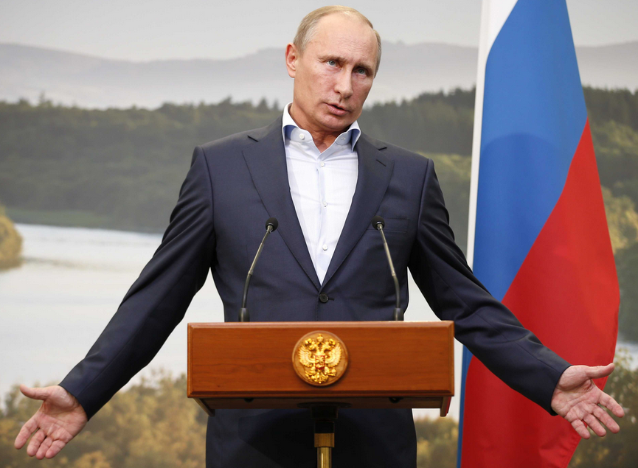
Russia
Eurasia
Strategic / defense relations: good
Trade relations: not so good.
Hardly 6 billion bilateral trade.

Slide 84
Russia
Eurasia
Custom clearance, pre-shipment inspection: complex and time-consuming
Russian importer needs to get license. Indian exporter has to pay his application fees!
product-specific approvals needed
SPS on Indian meat, egg, agro. Exports.
Banking and finance issues.

Slide 85
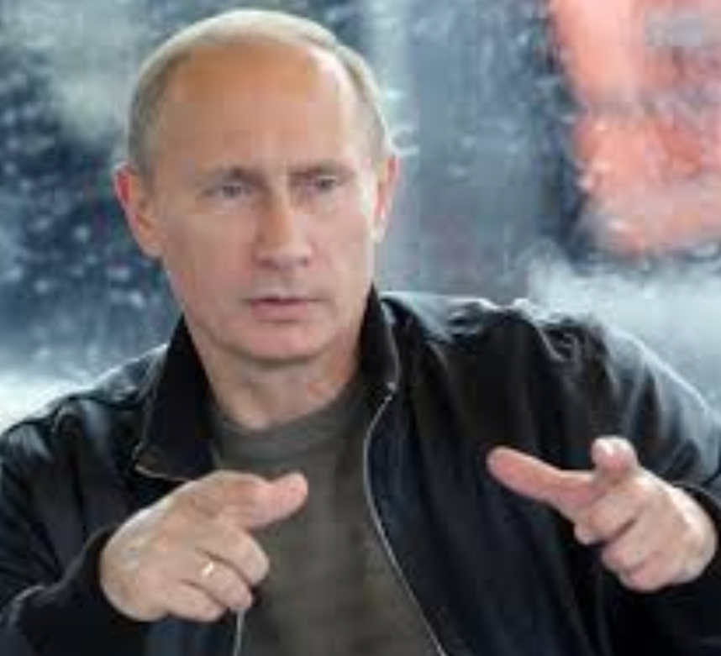
Russia Way Ahead
FTP-2015
Modi-Putin meet Dec. 2014
Joint statement
6 billion => 30 billion trade by 2025.
ALROSA, Russia’s largest diamond supplying company to sell rough diamonds to Indian cos. Directly. (~700 million$ per year)

Slide 86
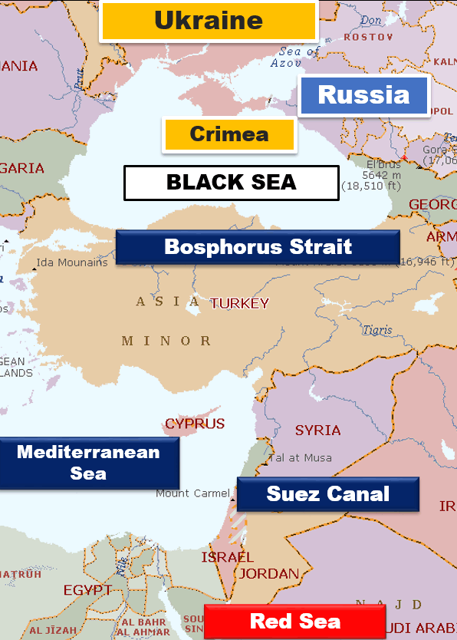

Slide 87

CIS
FTP-2015
Commonwealth of Independent States
12 countries: Kazakhstan, Turkmenistan, Uzbekistan, Kyrgyzstan, Tajikistan, Russia, Georgia, Azerbaijan, Armenia, Ukraine, Belarus and Moldova
Market: yes per capital income high
Raw material: petroleum, coal, natural gas, potash, metals and minerals.

Slide 88
CIS Way Ahead
FTP-2015
Complementary to Indian Mfg. sector: both market + raw material.
Value addition => EU market
Present: Mumbai => Dubai => St. Petersburg (long and expensive)
Future: Mumbai => Iran => Astrakhan (Russia)
Mumbai => Crimea =>CIS.
International north south transport corridor in future
End result: cheaper, faster transport

Slide 89
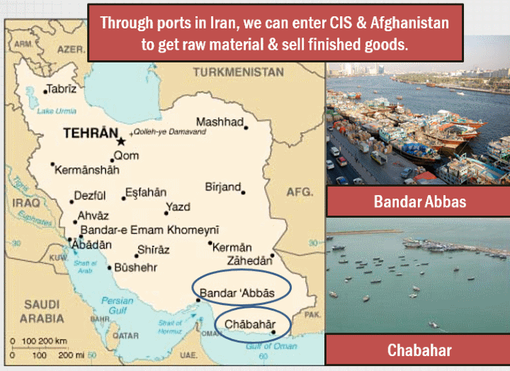
IRAN Angle (Article link)

Slide 90
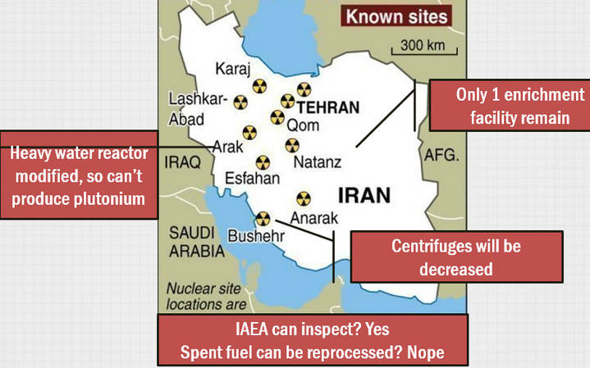
IRAN E3+3, P5+1, Laussane Deal (Article link)

Slide 91
IRAN E3+3, P5+1, Laussane Deal (Article link)
Iran
Oil ▼ = Arab spring
Israel attack
West
Post Iraq
Stuxnet
Sanction gone AIIB
3 months enough to make bomb

Slide 92
FTP-2015: Region wise Strategies
US,EU
China, Japan
SAARC
ASEAN
WANA
LAC
Russia, CIS
Africa
Env/ICT challenges
Explore non-EU
SAFTA service, Grid, Value added chain
FTAs: pro, anti
transport
Market access difficult
Language barrier
Russia = problem
CIS = market + RAW + EU entry

Slide 93
FTP-2015: Region wise Strategies
US,EU
China, Japan
SAARC
ASEAN
WANA
LAC
Russia, CIS
Africa
Env/ICT challenges
Explore non-EU
SAFTA service, Grid, Value added chain
FTAs: pro, anti
transport
Market access difficult
Language barrier
Russia = problem
CIS = market + RAW + EU entry
MERCOSUR PTA non started
Contract Farming
Project Loans
FTAs with Israel, GCC, SAU, COMESA, ECOWAS
Issues: port, Energy, Defense

Slide 94
Strategies to boost EXPORT

Slide 95
FTP-2015: Export Strategies: Product wise
Engg.
IT/Electronics
Defense
Agriculture
Textile
Gems Jewelry
Project Export
Pharma

Slide 96

Agriculture
FTP-2015
Inflation, food security
On / off export policy…x
Open export policy….yes
Post harvest, cold storage, farm2port connectivity
SPS: stringent quality norms in Advance. E.g only APEDA certified exporters can send Mangoes

Slide 97
Agriculture Way ahead
FTP-2015
Organic farming boost in NE
Sikkim declared as “Organic state”
Premium market in Jap, EU, USA
Plantation opportunity: >50lakh Indians
Tea Productivity stagnant, Pesticide limit issues, Sri Lanka-Kenya compete
Coffee: pest attack = R&D
Rubber Expand to Odisha, Maharashtra, Chhattisgarh, JHK.
Notes:
Plantation Products
plantations sector directly supports livelihoods of about 18 lakh small growers and more than 33 lakh workers,
majority of them resource poor, low income groups, inhabiting tribal and geographically challenging terrain,
challenges including stagnation in productivity due to the ageing plant material, impact of climate change including pests, scarcity of labour and volatile international prices.
Stringent food safety regulations
Programmes for expansion of rubber will be initiated in Chhattisgarh, Jharkhand and parts of Orissa and Maharashtra where areas suitable for rubber cultivation have been identified.
Through intensive efforts rubber plantations have expanded phenomenally in Tripura but there is still vast potential to expand rubber plantations in Assam and other Sstates of the North East.
? Coffee plantations are adversely affected by pests particularly the stem borer.
scientific and technological methods
While tea exports have remained stagnant, coffee exports have grown steadily but need to grow even further

Slide 98
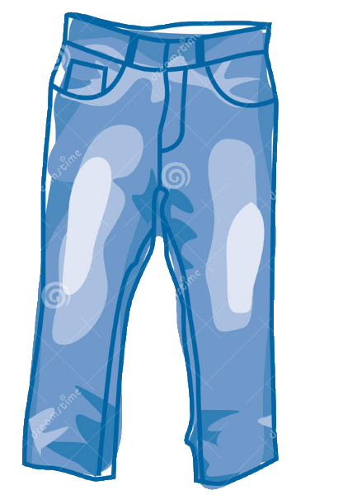
Textile
FTP-2015
Light Manufacturing Sectors: leather products and textiles
4.5 crore employed directly
cotton yarn export- advantage over China and Bangladesh
But need to move up the value chain (CMLV, Make outside India)
Product diversification in garments: women garments, synthetic textiles.

Slide 99
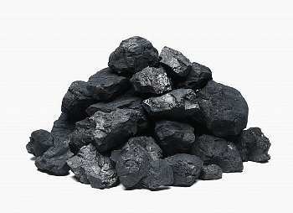
Mining
FTP-2015
export decline because
Ban on iron ore mining
Coal scam
Environment clearance problem
Make in India: more consumption expected @home.

Slide 100
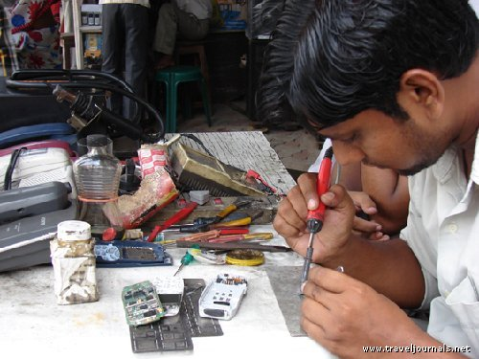
MSME
FTP-2015
45% MFG output
40% export
8% GDP.
6000 products
Budget 2015: Mudra, Atal, Setu (Ref. L5/P3.pptx)
FTP: Provide interest subvention for 3 years

Slide 101
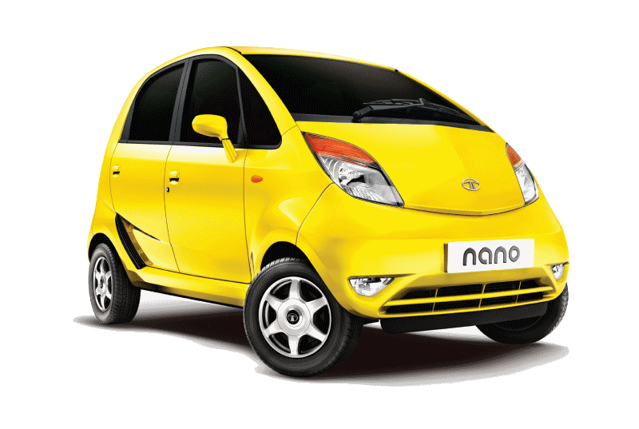
Engineering
FTP-2015
China: 12% of world export
India: hardly 1.2%
Low technology, high price
MSME designed product = no R&D
Small size car to Africa and WANA
The auto sector can be integrated with global supply chains.
subsidies and incentives….X
Innovation (AIM), skilling, FDI

Slide 102
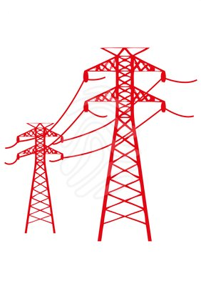
Project export
FTP-2015
Export of goods and services for “project” in foreign country
Railway lines & airports
Thermal Power station, electricity grids
Roads and bridges
Dams and canals
Particularly Africa, LAC, SAARC, ASEAN

Slide 103
Project Exports: WHY?
FTP-2015
Long term relationship of the target country with India
Soft diplomacy, High visibility
Repeat orders become easier
Spare parts, annual maintenance and servicing contracts, tech upgrades.
=Steady income from export over 5-20 years.

Slide 104
Project Exports: reform?
FTP-2015
Present 5 billion$. Target 25 billion in next 5 years.
Department of Commerce=> National Export Insurance Account (NEIA), to cover project export risks.
Exim Bank loan to project exporter Indian companies.
Cheap credit to target country with conditionality.

Slide 105
outgoing
incoming

Slide 106
FTP-2015: Export Strategies: Product wise
Engg.
IT/Electronics
Defense
Agriculture
Textile
Gems Jewelry
Project Export
Pharma

Slide 107

Electronics
FTP-2015
Compared to China, Taiwan, Korea and Japan……
High taxation
Electricity, loan, transport expensive
End result: Indian electronics 8-10% expensive than other. Export competitiveness Lost.
Even Indian demand met by imports

Slide 108

IT/ITES
FTP-2015
Single largest contributor to India’s service export
India’s IT export: 60% directed to US, 20% to EU
US/EU: slowdown, protectionist measures, data security laws hurts
Need to divert towards Japan, China and Korea
But language problem and unique features of these markets.

Slide 109
IT/ITES
FTP-2015
E-Commerce, Cloud Computing, Mobile Applications
Also explore Healthcare, education, R&D, consultancy,
Printing, publishing and entertainment services

Slide 110
Services issues
FTP-2015
healthcare, education: deceptive practices
Must enforce minimum standards e.g. wellness centres claiming to be Ayurvedic / yoga centres.
Global exhibition for all types of services
Help big players meet Indian startups.

Slide 111
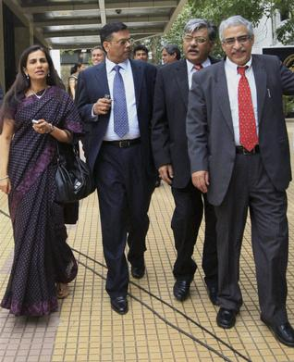
MICE
FTP-2015
Meetings, incentives, conventions, exhibitions (MICE)
300 billion market. India hardly 1%
Pragati Maidan, Delhi – alone not sufficient.
Need convention infrastructure, even in tier1, tier2 cities.

Slide 112
FTP-2015: Export Strategies: Product wise
Engg.
IT/Electronics
Defense
Agriculture
Textile
Gems Jewelry
Project Export
Pharma

Slide 113

Pharma Strength
FTP-2015
3rd Rank globally
10% of global trade
Grip over Generics Market (i.e. drugs produced after patent expires) hence Affordable to third world.

Slide 114
Pharma
FTP-2015
Bad media publicity of poor quality of Indian drugs esp. Ranbaxy
Approval to sell in China: need 3-4 years
Chinese drug regulator asks for detailed mfg. process, perform new clinical trials again in China.

Slide 115
Pharma Solutions
FTP-2015
Spurious / fake drugs in international market- blamed to India.
1/4/2015: Trace and track policy.
Bar codes to all medicines- expiry date, price, source mfg. etc.
Penalties under Drugs and Cosmetics Act 1940

Slide 116
Pharma Solutions
FTP-2015
India Brand Equity Foundation (IBEF) – a trust by Department of Commerce.
Will run special campaigns for pharma products.
100% FDI permitted in Medical devices – future area for growth.

Slide 117
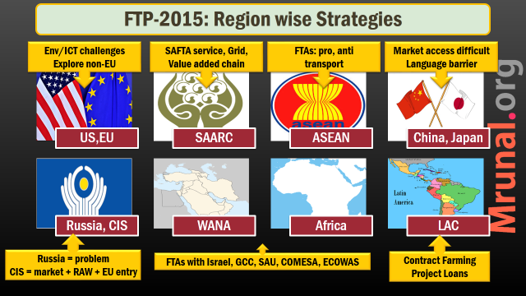
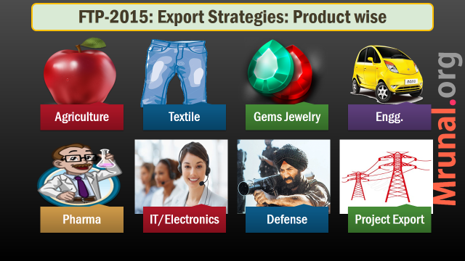

Slide 118
Boost Export HOW? = Foreign Trade Policy 2015-20
Strategies
Schemes
Ease of Doing Biz.
Targets
Trade Agreements

Slide 119
Scrips & schemes
Ease of Doing
Infra.

Slide 120
FTP-2015: Duty scrip schemes
Before: 5
Focus Product Scheme Focus Market Scheme
After: 5
Merchandise Exports from India Scheme (MEIS).
Market Linked Focus Product Scheme Agri. Infrastructure Incentive Scrip
Vishesh Krishi And Gram Udyog Yojana (VKGUY).
Service Exports from India Scheme (SEIS)

Slide 121



Service export from India scheme (SEIS): 5% scrip
$100
$100
Can use paying Taxes
$5

Slide 122
MEIS & SEIS scrip
FTP-2015
Payment of Customs Duties to import of inputs
Payment of Excise Duties on domestic procurement of inputs or goods.
Payment of Service Tax on procurement of services
Payment other fees.

Slide 123
MEIS not applicable
FTP-2015
SEZ/EOU/EHTP/BPT/FTWZ
Red sanders and beach sand (Environment)
Diamond, Gold, Silver, Platinum (CAD)
Mineral ores (need for Make in India)
Cereals, sugars, milk, meat. (inflation & food security)

Slide 124

Existing schemes
FTP-2015
Export Promotion Capital Goods Scheme: Duty free import for capital goods for pre- production, production and post-production
Niryat Bandhu (2011): help new entrepreneurs for export. Technical advisory, handholding. Existing scheme to be streamlined
Town of Export excellence: funding
ASIDE: Assistance to States for Developing Export Infrastructure and Allied Activities

Slide 125
Scrips & schemes
Ease of Doing
Infra.

Slide 126

Border Transport
FTP-2015
If export stock seized for irregularity - release in 7 days.
Faster clearance to agro/perishable produce.
http://dgft.gov.in : Exporter importer profile. Once PAN card, registration details, mobile number, email id etc. registered, no need to upload every time.

Slide 127
E-Governance
FTP-2015
# of docs. Required for import export
Only 3
Max. Time for clearance
3 months
Cost of import export
reduced

Slide 128


Status holder =faster clearance
FTP-2015

Slide 129
Scrips & schemes
Ease of Doing
Infra.
Inspection
E-Gov.
Status Holder
SEZ
Export houses
TEE, ASIDE

Slide 130

SEZ
FTP-2015
1965: Export processing zone @Kandla, Gujarat
2005: SEZ Act
SEZ Bottom-line: Export promotion through tax incentive.

Slide 131
SEZ performance
FTP-2015
Parameter | 2006 | 2014
Exports | 22k | 5 lakh crores
Investment | 4k | 4 lakh crores
Jobs | 1.3 lakh | 13 lakh

Slide 132
SEZ improve following
FTP-2015
Automated repeat clearances to import of raw material, export of finished goods.
Develop world class infra. With upstream, downstream, road, rail and port connectivity.

Slide 133
Export units
FTP-2015
EXPORT ORIENTED UNITS (EOUs),
ELECTRONICS HARDWARE TECHNOLOGY PARKS (EHTPs),
SOFTWARE TECHNOLOGY PARKS (STPs)
BIO-TECHNOLOGY PARKS (BTPs)

Slide 134
Export units
FTP-2015
Can import raw material /components /machinery @0% custom duty. Condition- must export back.
Faster clearance to their (15 days)
Don't need industrial license to produce items reserved for SSI sector.
Don't need to furnish bank guarantee while importing.
100% FDI automatic route

Slide 135


Transport infra.
Support infra.
Road connectivity to ports
rail heads
airport
Common packaging, labelling centres
More quality testing labs
More warehouses
More cold storages for pharma and perishables

Slide 136


Slide 138


Slide 139

Only 2
interview tips
Tell me something about yourself? Ans. finished graduation in 2007.
Stick to the sales pitch.
Why Civil Service? Ans. Noble
Other questions.
But you have good opportunities in private sector? Ans. Desperate and guilty.

